Slide 1
c/w Dualism 07/05/2020
List three mental activities and three physical activities
Mental activities | Physical Activities

Slide 2
Learning Objectives
To describe the Mind-Body Problem.
To explain Descartes’ arguments in favour of dualism.
To assess the effectiveness of dualism as a response to the Mind-Body Problem.

Slide 3
Mind-Body Problem
What is the relationship between the mind and body
Are minds physical things?
If so, how are they differentiated from other physical things?
If not, how are they related to physical things?

Slide 4
Possible solutions
Dualism
Monism
Materialism
Idealism
Substance
Property

Slide 5
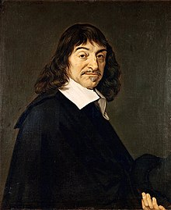
Substance Dualism
Mind and body are separate substances
Substance is a subject which has various properties e.g. mug is breakable, patterned etc.
Properties cannot exist on their own without a substance which has those properties.
Mind = substance with properties of thoughts, intentions, feelings, indivisible
Body = substance with its own properties e.g. extended in space, divisible, not conscious

Slide 6
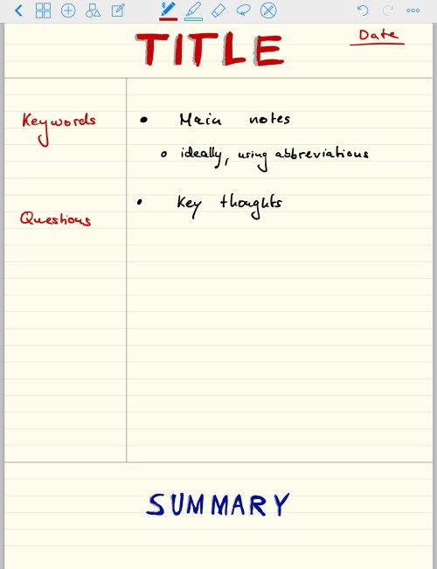


Slide 7
Descartes’ Evil Demon Hypothesis
Nevertheless, the belief that there is a God who is all powerful, and who created me, such as I am, has, for a long time, obtained steady possession of my mind. How, then, do I know that he has not arranged that there should be neither earth, nor sky, nor any extended thing, nor figure, nor magnitude, nor place, providing at the same time, however, for ^{t}e rise in me of the perceptions of all these objects, and] the persuasion that these do not exist otherwise than as I perceive them? And further, as I sometimes think that others are in error respecting matters of which they believe themselves to possess a perfect knowledge, how do I know that I am not also deceived each time I add together two and three, or number the sides of a square, or form some judgment still more simple, if more simple indeed can be imagined?¹

Slide 8
Cogito ergo sum = I think, therefore I am
Far from it; I assuredly existed, since I was persuaded. But there is I know not what being, who is possessed at once of the highest power and the deepest cunning, who is constantly employing all his ingenuity in deceiving me. Doubtless, then, I exist, since I am deceived; and, let him deceive me as he may, he can never bring it about that I am nothing, so long as I shall be conscious that I am something. So that it most, in fine, be maintained, all things being maturely and carefully considered, that this proposition (pronunciatum) I am, I exist, is necessarily true each time it is expressed by me, or conceived in my mind.

Slide 9
Two arguments from Descartes
Argument from doubt
I cannot doubt that I exist (Cogito)
I can doubt the existence of any physical thing (Evil Demon)
Therefore, I am not identical to any physical thing.
Therefore, I am a thinking thing that is not identical to any physical thing.
The Divisibility Argument
My body is divisible
My mind is not divisible
Therefore, my mind is not identical to my body.
Problem: My mind is one sense is divisible: I have individual beliefs and memories which could be removed and replaced. I also have different cognitive faculties like reasoning and perception. I can lose these in the same way I could lose an arm or a leg
Problem: What we believe or not believe or doubt does not tell us much about how things actually are.

Slide 10

A modular theory of the mind
https://www.coursera.org/lecture/science-of-meditation/what-mental-modules-are-GUn1P
Mind is divisible – theory that there are seven higher modules
Kenrick/Griskevicius - no president, just cabinet secretaries 'higher modules'

Slide 11
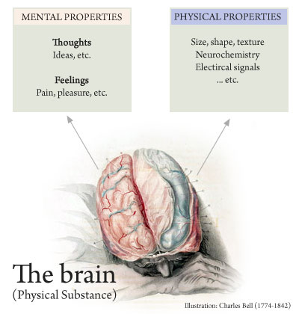
Property Dualism
Brain processes cause mental states
Mental state is an emerging property
Mental states are nonphysical but form a novel class of features of the brain with properties (such as meaning and awareness) that are different from that of matter
Relation between brain and mental states are causal
Mind is material but has properties which cannot be reduced to physical properties

Slide 12
Problems of Substance Dualism
Problem of Interaction: Substance dualists cannot explain how mental thoughts can cause physical responses e.g. how when I feel embarrassed (mental state) I blush (physical state)
Problem of other minds: if mind is separate from other bodies, then we can only know that other people have bodies but we have no way of knowing whether they have mind.
Category Error (Ghost in the Machine)

Slide 13
Zombie Argument
Read the Routledge Handout on Property Dualism
1. What are the easy and hard problems of consciousness according to Chalmers? 2. What is property dualism? 3. Examine the Zombie Argument against materialism. How convincing is it?

